Slide 1
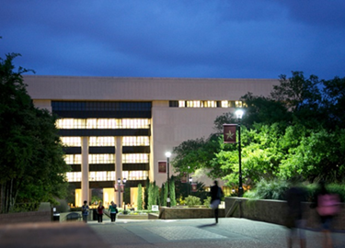
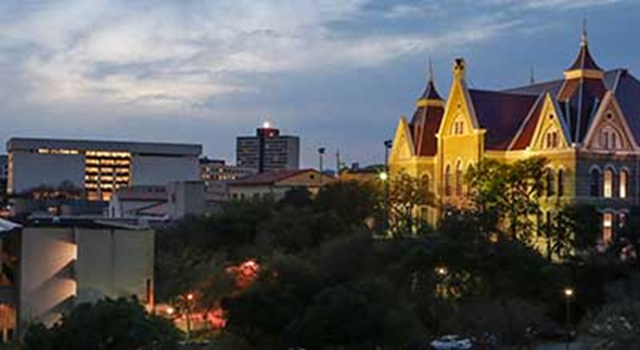
Current Issues and Possibilities
For Academic Libraries
Ray Uzwyshyn, Ph.D. MLIS MBA
Director, Collections and Digital Services
Texas State University Libraries
2018

Slide 2
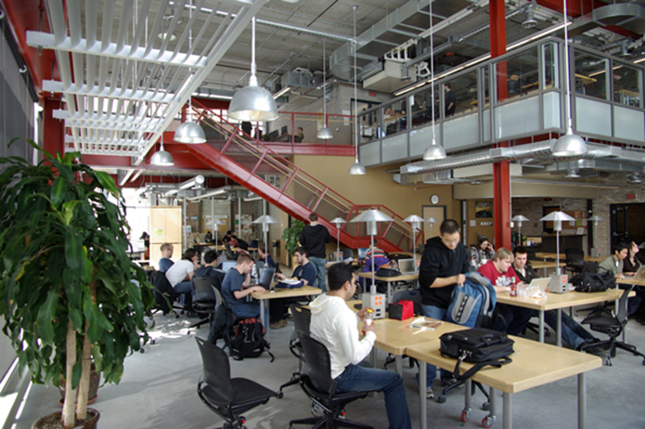
The Physical Library is Changing
85 % of Materials Purchases are currently Electronic Resources, e-journals and e-books.
Only 15% of purchases are print materials (12% print books, 3% print serials).
Collection Management and Digital Services are experiencing a Paradigm Shift

Slide 3
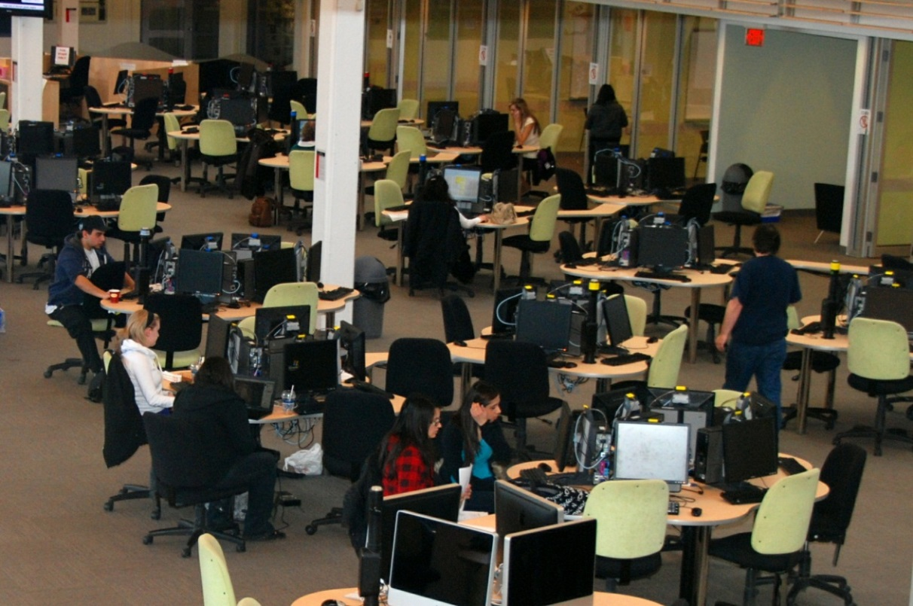
Book Warehouse Model Disappearing
Digital Services Collections are Expanding
Student/Faculty Centered Collaborative Learning Spaces,
Digital Literacy Labs, Multimedia Studios

Slide 4
The Physical Library is transforming to Technology Rich Learning Commons
Interdisciplinarity, Digital Literacy, Multimedia, Specialized Software, Hardware , Human Resources

Slide 5
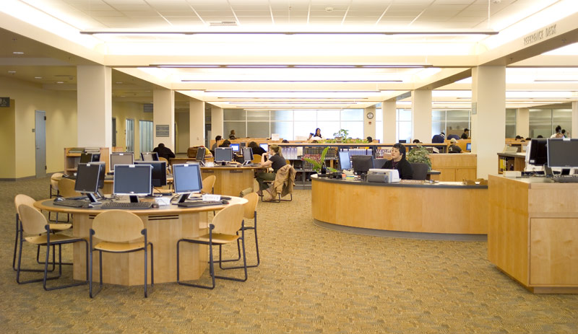
Collaboration is the Keyword for Physical and Digital Library Environments
Collaboration among Audiences
Faculty Students, Librarians/Staff Academic Community
Collaboration Among Divisions
Library
Academic Technology
Faculty Teaching Centre
Core Systems/Technology Resources
Online Learning Division
University IT
Writing Center

Slide 6
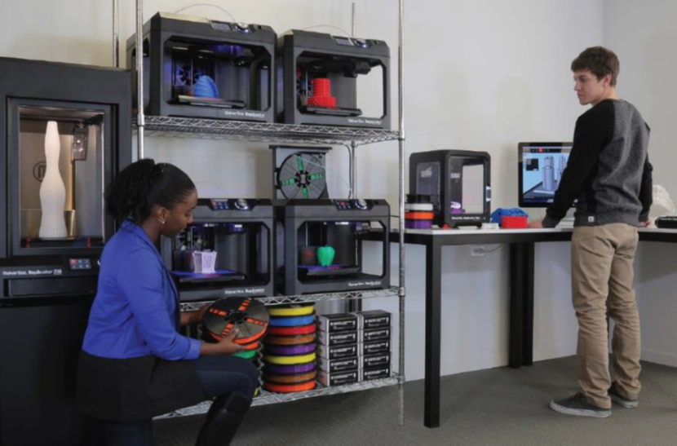
Spectrum of New Technologies Possible
Visualization Walls, Makerspaces, Instant Theatres, 3D Printing Labs

Slide 7


Opportunities to Reimagine Digital and Collection Services for 21st Century
Faculty/Student/Curriculum &
Research Relationships
University/ Classroom/Library Relationships

Slide 8
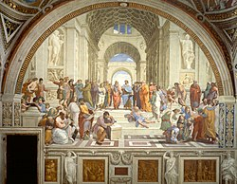
Reestablishment of a Renaissance Model of
Interdisciplinarity
Library
Humanities &
Social Sciences
Sciences
Library as
Third Space for Learning
Convergence of Space, Technology, Learning
Technologists &
Engineering
Cross-fertilization of
Projects, People, Skillsets

Slide 9
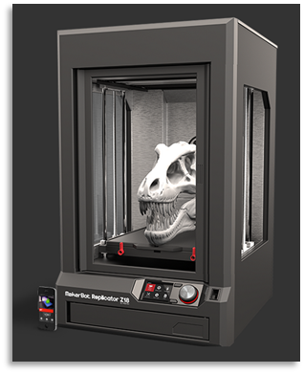
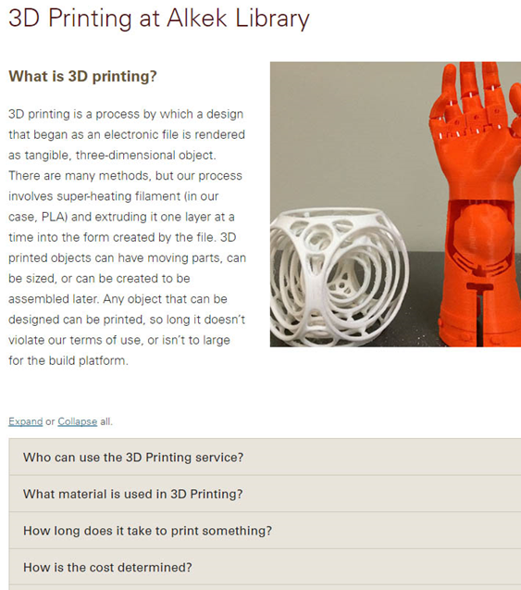
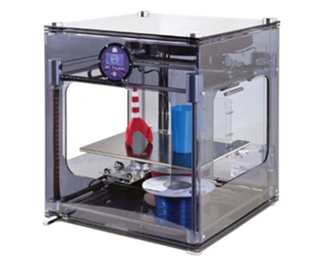
New Digital Literacies Possible
Student and Faculty as Producer

Slide 10
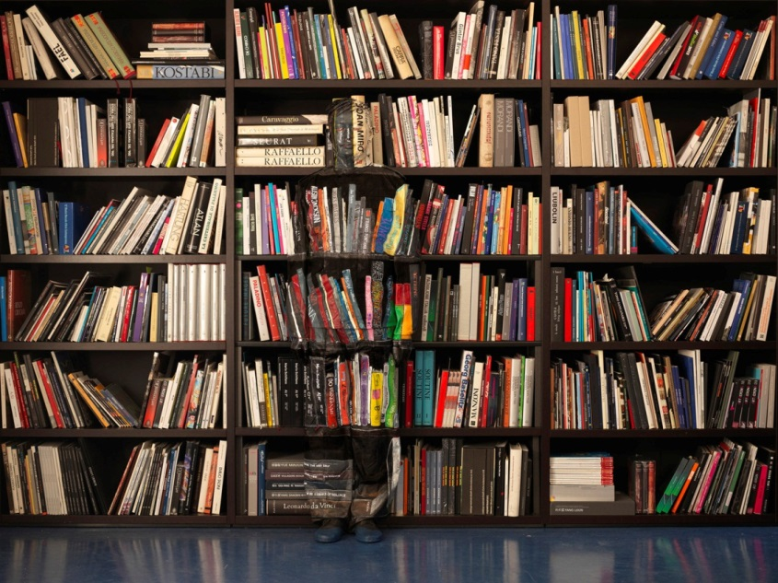
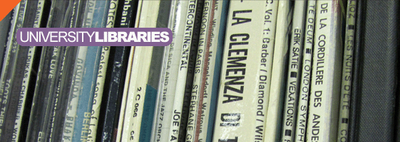
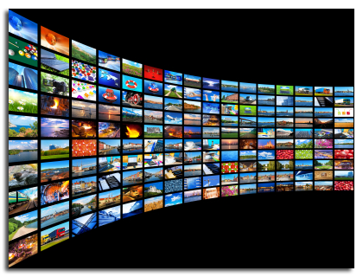
Collection Development Priorities Transforming Through Digital Resource Possibilities & Media
Collection Development Priorities
Shifting
Changing Models From
Ownership of Books to Access to Information

Slide 11
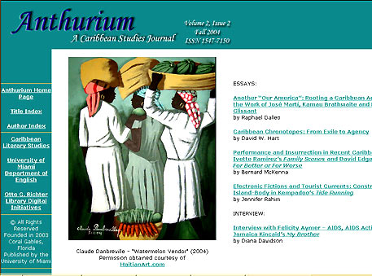

New Genres of Digital Library Services Appearing
Enabling Faculty Research
Scholarly Refereed E-Journals
Open Source Publishing Opportunities

Slide 12
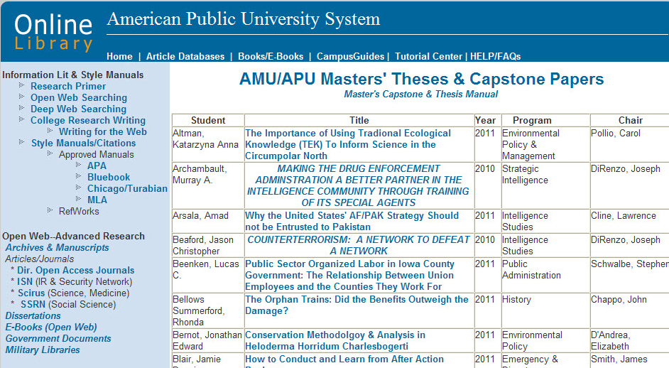
Enabling Student Research Online
ETD’s Electronic Thesis and Dissertations
Online Masters Thesis Archive/Capstone/Online Library
(Dark Archives & Institutional Repositories)

Slide 13
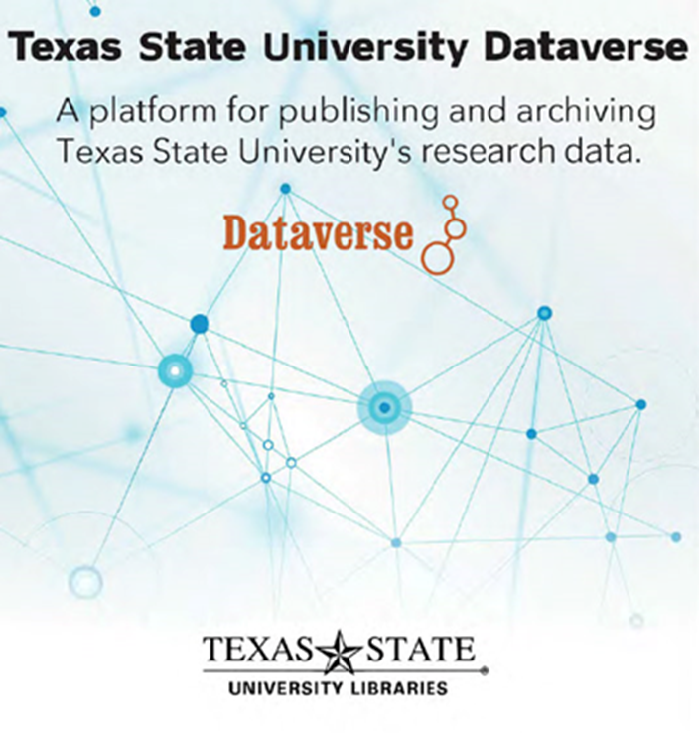
Data Literacy and Data Research Repositories
The Texas Online Data Research Repository.

Slide 14

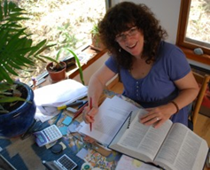
Library/University Press Scholarly Publishing
Academic Books and Scholarly Journals
In House Library e-presses (Espresso Book Machine)
University Publishing Infrastructures
E-Press
Editor

Slide 15

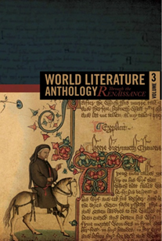
Faculty Library/E-Press Synergies
Publishing on Demand (POD)
Books and Faculty Publications

Slide 16
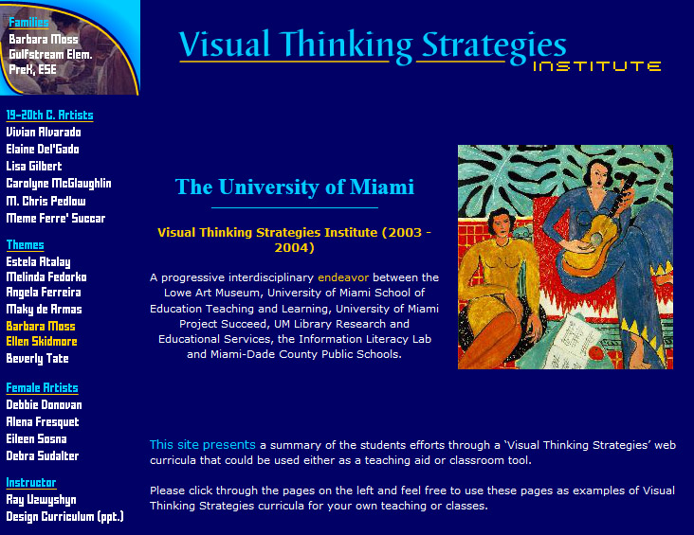
Innovative Partnerships
Faculty Divisions, the Library and Schools
Digital & Information Literacy/ Interdisciplinarity
Partnerships with Library
School of Education
University Art Department/Museum
State Bureau Of Education Grant

Slide 17
Period of High Relevance for Information Literacy
The ACRL Framework for Information Literacy and the Six Major Frames.
Fake News & Unreliable Information Sources
are widespread.
Librarians Educate Students on Information Seeking
Refereed Scholarly
Journals etc.

Slide 18

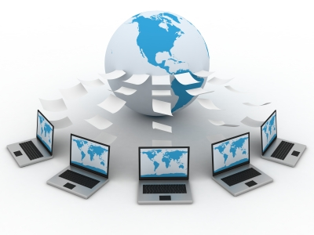
Online Library Services Expanding
Research Help Systems, Knowledge bases,
Combining Online Libraries & Learning Management Systems

Slide 19
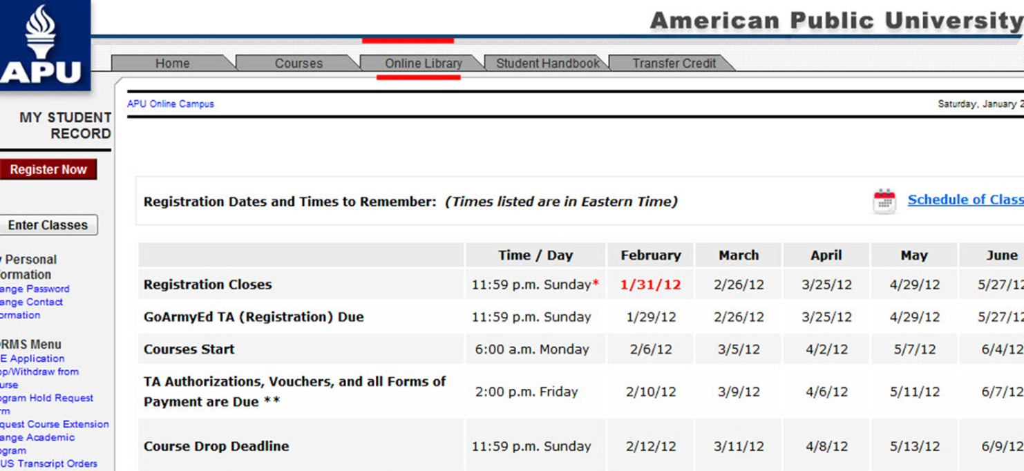
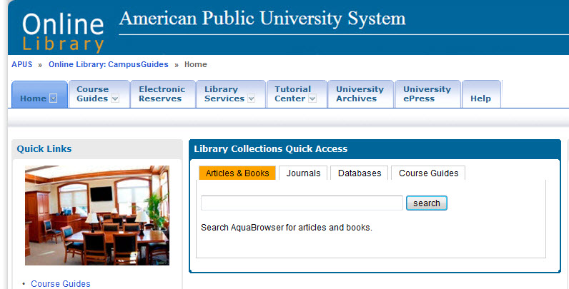
Tight Library Integration with Online Classroom is Possible
Learning Management System

Slide 20
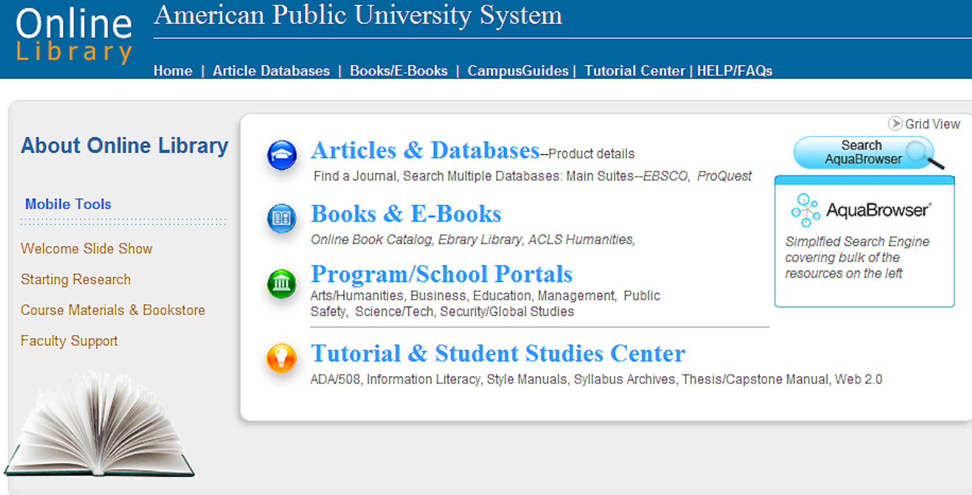
The Textbook is Evolving to Online Modalities
Many Possibilities for Synthesis with Library Resources
The Online library is central to physical, online and hybrid university models.
Serving Curricular and Research Needs
(E-Books, E-Articles, OER, Media)

Slide 21
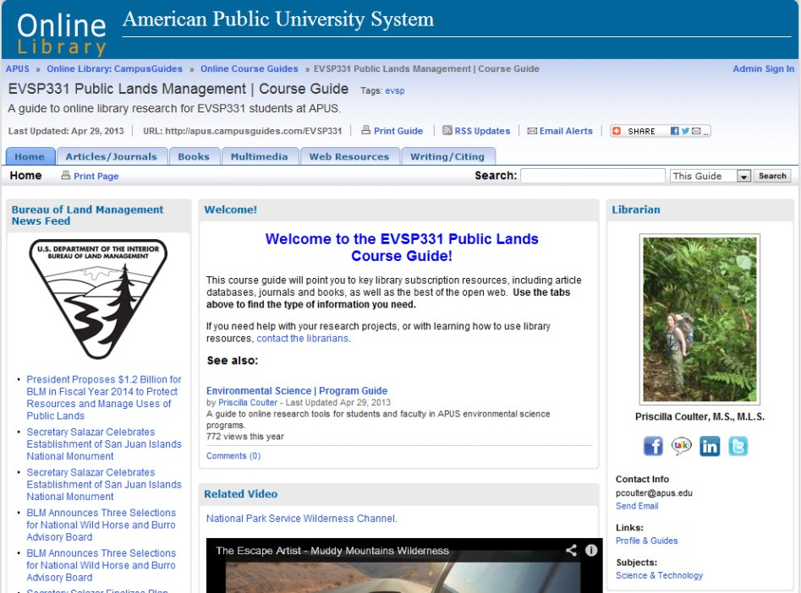

Library Partnerships with Faculty
Online Course Guides
Direct
Curricular
Replacement
Secondary
Multimedia
Bibliography
University Global
Marketing/Branding/ROI

Slide 22
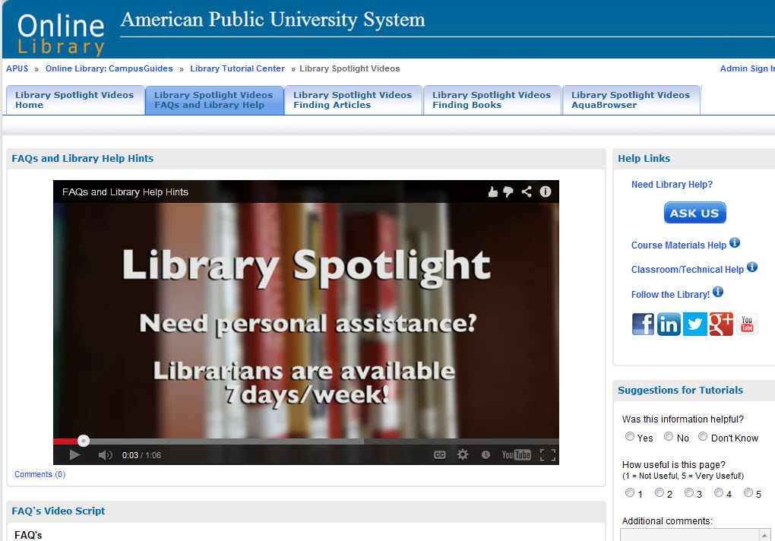
Many Online Video Possibilities
Help Systems

Slide 23
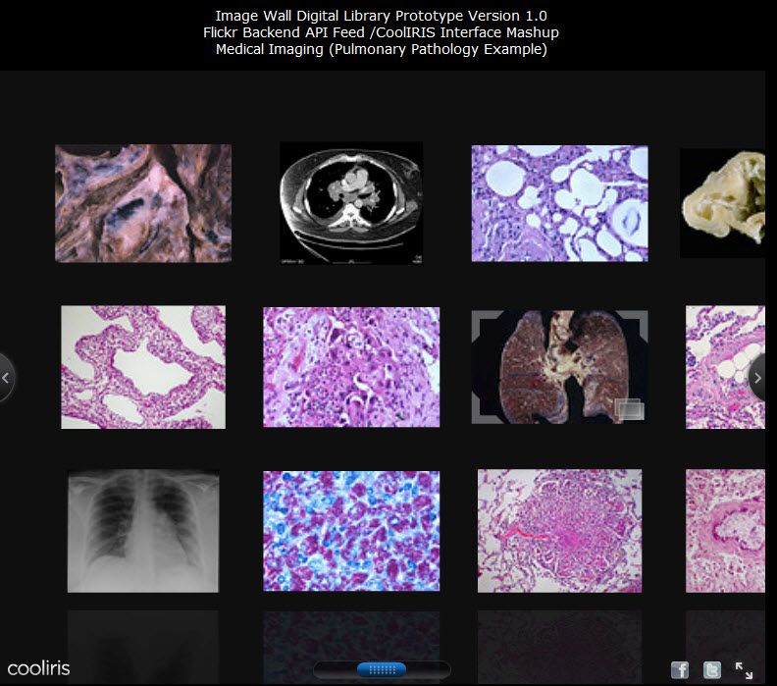

University Archives and Special Collections are Going Digital and Online
From Public History to Biomedical Science (Pulmonary Pathology)

Slide 24
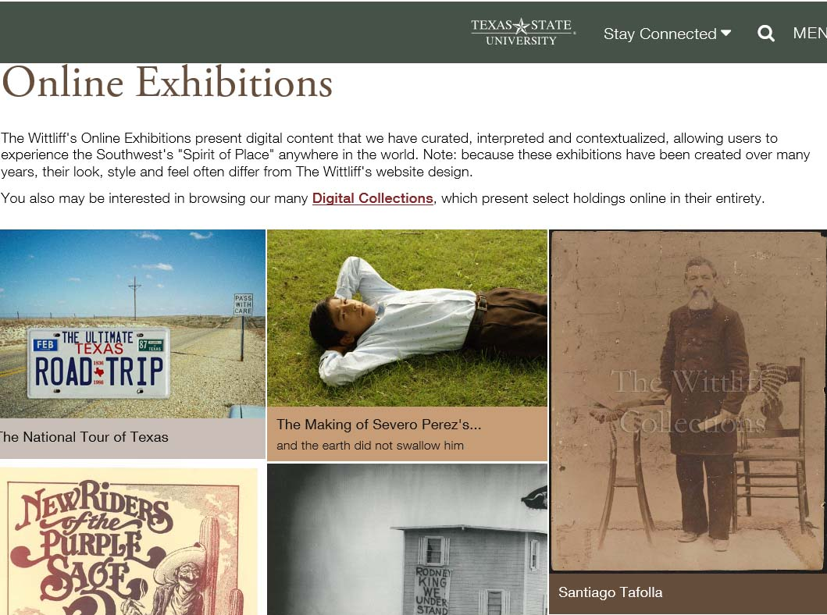
New Online Exhibition Possibilities
Many
Software Options

Slide 25
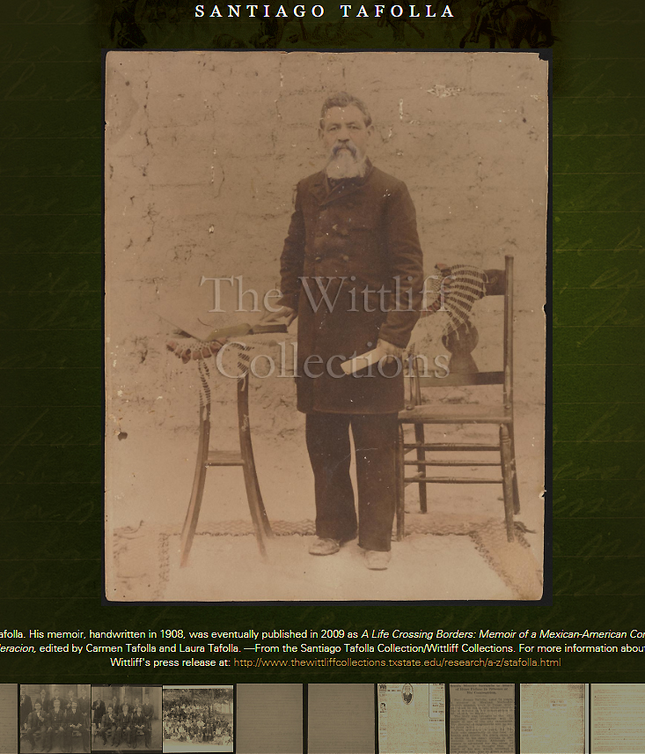

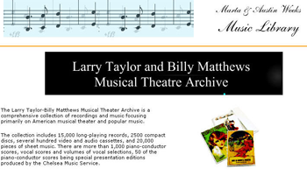
Branding and Marketing the Libraries and University’s Intellectual Riches Globally

Slide 26
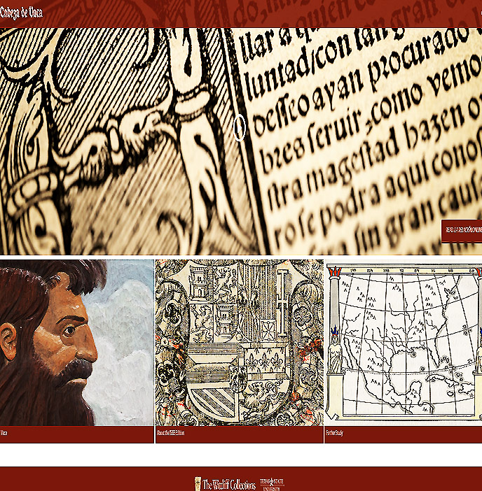
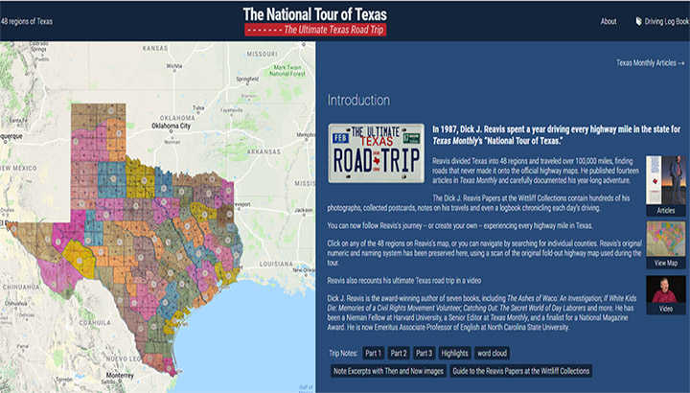
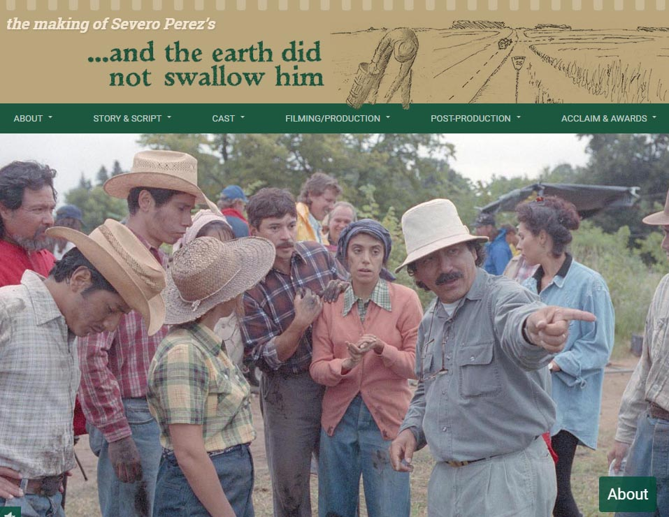
Enabling Digital Scholarship
Collaboration with Research Scholars
Special Collections and the Community

Slide 27
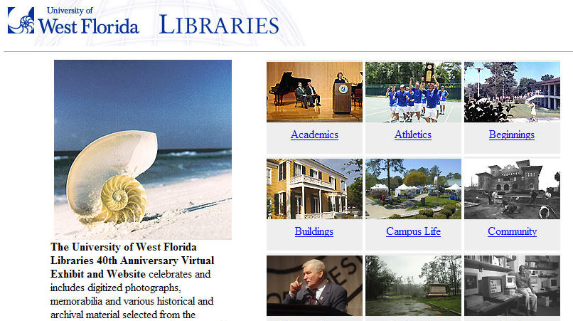
Creating University, Library,
Local and Global Community Bridges

Slide 28
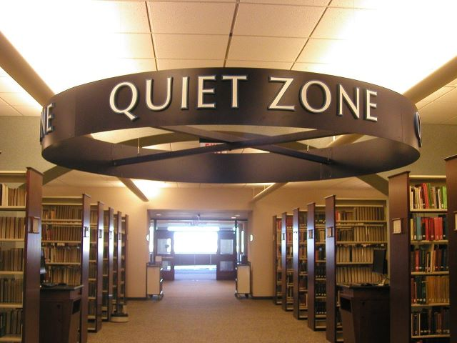
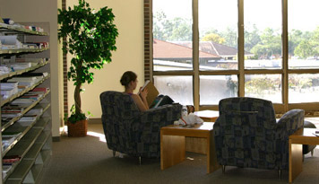
Maintaining Historical Continuity while balancing changing necessities
Libraries are Still Places of
Inspiration, Reflection, Study

Slide 29
Thank you!
Comments or Questions
Ray Uzwyshyn Ph.D. MBA MLIS
http://rayuzwyshyn.net
ruzwyshyn@gmail.com

Slide 30
Evolution of the Scholarly Record Online
Evolution of online library tools, 1990-2020 with regards to level of interactivity and media range.

Slide 31
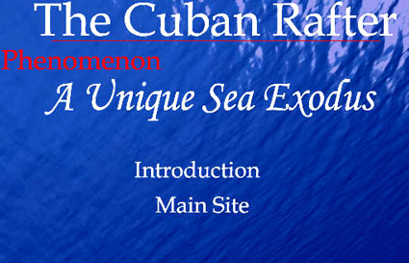
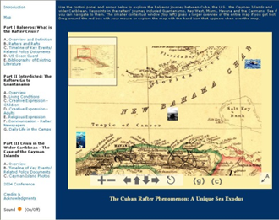
Engagement With Faculty Research/ Special Collections
New Genres of Digital Archives Possible

